Slide 1

Consent Gateway Campaign Flow
Ghana | Airteltigo
LISBON | PRIVATE & CONFIDENTIAL
Notes:
From website

Slide 2
Introducing DOI
Content Provider Banner
TWT LP with CP product details
TWT LP for DOI with HE
Success and confirmation
CP calls the new flow for subscription
CP receives confirmation of subscription or TWT redirect to CP page

Slide 3

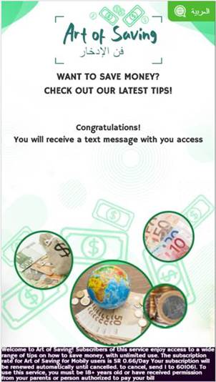
EXAMPLE – HE FLOW
HE flow: 1ST click, second click / confirmation, congrats
1
2
3
SUBSCRIBE
CONFIRM

Slide 4
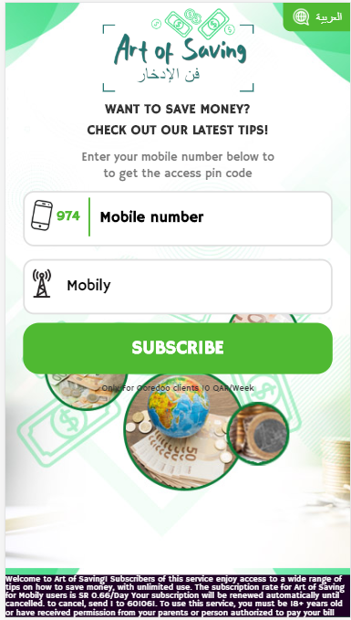
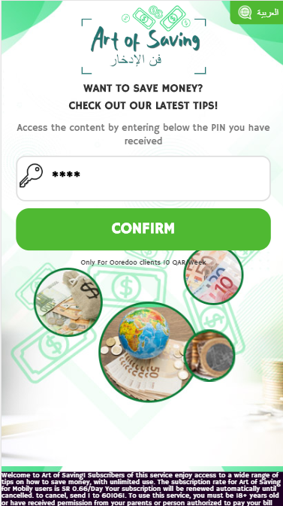

EXAMPLE – WIFI FLOW
WIFI FLOW: msisdn page, pin page, congrats
1
2
3

Slide 5

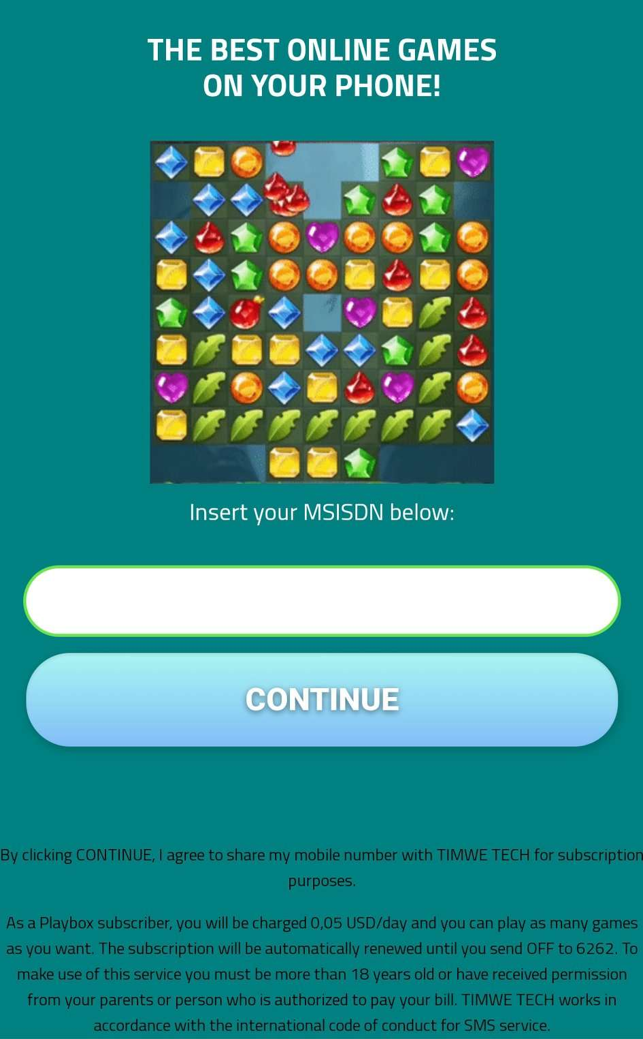
Customizable Pages
This template an example of landing page.
Maintaining the layout of the Landing Page, all the following assets can be customizable, provided that each CP will share the information with TWT:
Font type, color and size;
Background;
The logo in PNG customizable for every type of background
Buttons
Image

